Slide 1
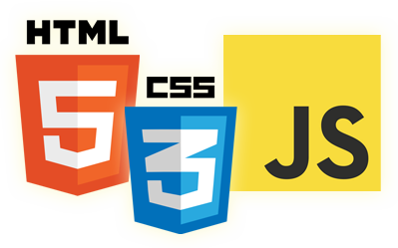


Execution Context & Scope
Eyal Vardi
Microsoft MVP ASP.NET blog: eyalvardi.wordpress.com

Slide 2
Agenda
Hoisting
Execution context
Closures
Variable Pattern
Recursion with functions
Garbage collection

Slide 3
Hoisting
JavaScript program isn’t interpreted line by line, top-down in order, as the program executes.
d = 'ev';
var d;
console.log(d);
var d;
d = 'ev';
console.log(d);
Only the declarations themselves are hoisted, while any assignments or other executable logic are left in place.

Slide 4
Functions First
Both function declarations and variable declarations are hoisted.
Functions are hoisted first , and then variables.
test(); // 1
var test;
function test() {
console.log(1);
}
test = function () {
console.log(2);
};
function test() {
console.log(1);
}
test(); // 1
test = function () {
console.log(2);
};

Slide 5
Hoisting Internals
try {
printOne();
printTwo();
} catch (e) {
console.log(e.message);
}
// Function Expression
var printOne = function () {
console.log("One");
}
// Function Statement
function printTwo() {
console.log("Two");
}
var printOne = undefined,
printTwo = undefined;
printTwo = function () {
console.log("Two");
}
try {
printOne();
printTwo();
} catch (e) {
console.log(e.message);
}
printOne = function () {
console.log("One");
}

Slide 6
Declarations vs. Expressions
Function declarations are read and available in an execution context before any code is executed.
Function expressions aren’t complete until the execution reaches that line of code.
Declaration hoisting
Expression, unexpected identifier error.
alert( sum(10, 10) );
function sum(num1, num2) {
return num1 + num2;
}
alert(sum(10, 10));
var sum = function (num1, num2) {
return num1 + num2;
};

Slide 7
Execution Context & Scope

Slide 8
When Function Created
function add(num1, num2) {
var sum = num1 + num2;
return sum;
}
When the add() function is created, its scope chain is populated with a single variable
object
add.length === 2;
Object.getPrototypeOf(add) === Function.prototype;
Add
[[Scope]]
Scope Chain
0
Global Object
this | Windows
windows | (object)
document | (object)
add | (function)
… | …

Slide 9
When Function Executing
var Total = add( 5 , 10 );
Activation object
this | Windows
arguments | [ 5 , 10 ]
num1 | 5
num2 | 10
sum | undefined
add(5,10) Execution context
Scope chain
Scope Chain
0
1
Global Object
this | Windows
windows | (object)
document | (object)
add | (function)
… | …
Executing the add function triggers the creation of an internal object called an execution context.

Slide 10
Scope Chain
Windows
color
changeColor()
anotherColor
swapColos()
tempColor()
var color = "blue";
function changeColor() {
var anotherColor = "red";
function swapColors(){
var tempColor = anotherColor;
anotherColor = color;
color = tempColor;
// color, anotherColor, and tempColor
// are all accessible here.
}
// color and anotherColor are accessible here,
// but not tempColor.
swapColors();
}
//only color is accessible here
changeColor();

Slide 11
When Function Executing
Each execution context is unique.
multiple calls to the same function result in multiple execution contexts being created.
The execution context is destroyed once the function has been completely executed.

Slide 12
The Activation Object
Acts as the variable object for this execution and contains entries for:
local variables
named arguments
Arguments collection
this
Pushed to the front of the scope chain.
When the execution context is destroyed, so is the activation object.

Slide 13
Arguments is an Array-like Object
Activation object
arguments
this
named arg’s
local var’s
arguments.callee
Reference to the currently executing function.
arguments.caller
Reference to the function that invoked the currently executing function.
arguments.length
Reference to the number of arguments passed to the function.

Slide 14
Arrays vs. arguments
The arguments object is not an array.
It is not a product of the Array constructor.
Changing the length of arguments has no effect on its indexed properties.

Slide 15
Make Arguments a Real Array
Array.prototype.slice.call(arguments)
var obj = { '0': 'zero', '1': 'one', '2': 'two', '3': 'three', '4': 'four', length: 5 };
var sliced = Array.prototype.slice.call(obj, 3);

Slide 16
Verifying all named arguments are supplied
function requireAllArgs(fn) {
return function() {
if (arguments.length < fn.length) {
throw(["Expected", fn.length, "arguments, got", arguments.length].join(" ") );
}
return fn.apply(this, arguments);
}
}
var divide = requireAllArgs(function(a, b) {return a/b});
divide(2/5); //"Expected 2 arguments, got 1"
divide(2,5); //0.4

Slide 17
this
Activation object
arguments
this
named arg’s
local var’s
The value of this is not determined until the function is called.
The rules for this:
f(id) // this == window
{}.f(id) // this == {}
f.call({},id) // this == {}
f.apply({},[id]) // this == {}
f.bind({}) // this == {}
new f(id) // this == {}
function f(id){ console.log(this);}

Slide 18
this Example
var name = "Global";
function Demo1() {
var func1 = function () { return this.name; };
var ObjA = {
name: "A",
getName: function() { return this.name; }
};
var ObjB = {
name: "B",
getName: function () { return this.name; }
};
var a = this;
alert( func1() );
alert( ObjA.getName() );
alert( ObjB.getName() );
}
Demo1();
“Global” , “A” , “B”

Slide 19
Call() Sample
window.color = "red";
var o = { color: "blue" };
function sayColor(){
alert(this.color);
}
sayColor(); //red
sayColor.call(this); //red
sayColor.call(window); //red
sayColor.call(o); //blue

Slide 20
Apply() Sample
function fullName(fName, lName) {
this.fn = fName + " " + lName;
return this;
}
function callfullName (fName, lName) {
this.name = "cfn";
return fullName.apply(this, arguments);
}
function applyfullName (fName, lName) {
this.name = "afn";
return fullName.apply(this, [fName, lName]);
}
alert(new callfullName("E" ,"V")); // {name:'cfn',fn:'E V'}
alert(new applyfullName("E" ,"V"));// {name:'afn',fn:'E V'}

Slide 21
Variable Declaration
Activation object
arguments
this
named arg’s
local var’s
Using var automatically added to the most immediate context available.
If a variable is initialized without first being declared, it gets added to the global context automatically.

Slide 22
No Block-Level Scopes
JavaScript’s lack of block-level scopes is a common source of confusion.
function f(){
if (true) {
var color = "blue";
}
alert(color); // "blue"
}

Slide 23
No Block-Level Scopes
function outputNumbers(count) {
for (var i = 0; i < count; i++) {
alert(i);
}
alert(i); //count
}
// Solutions
function outputNumbers(count) {
(function () {
for (var i = 0; i < count; i++) {
alert(i);
}
})();
alert(i); //causes an error
}

Slide 24
Scope Chain Augmentation
The catch block & a with statement create scope chain.
function buildUrl() {
var qs = "?debug=true";
with(location){
var url = href + qs;
}
return url;
}
Referring to location.href
function’s context
Location itself is added to
the front of the scope chain
Add to function context

Slide 25
Scope Chain Augmentation
with variable object
href | string
Activation object
this | Windows
arguments | [ 5 , 10 ]
qs | string
url | string
buildUrl() Execution context
Scope chain
Scope Chain
0
1
2
Global Object
this | Windows
windows | (object)
document | (object)
buildUrl | (function)
… | …

Slide 26
Dynamic Scopes
A dynamic scope is one that exists only through execution of code and therefore cannot be determined simply by static analysis.
with statement.
catch clause of a try-catch statement.
a function containing eval().

Slide 27
Dynamic Scopes
function execute(code) {
function subroutine() {
return window;
}
eval(code);
//what value is w?
var w = subroutine();
};
execute("var window = {};")

Slide 28
Closures

Slide 29
Closures
Closures are functions that have access to variables from another function’s scope.
function addEvent() {
var id = "xdi9592";
document.getElementById("save-btn").onclick = function (event) {
saveDocument( id );
};
}
From parent scope

Slide 30
Closure Scope
When the closure is created, its [[Scope]] property is initialized with function activation object and global object.
Activation object
this | Windows
arguments | []
id | “xdi9592”
Scope Chain
0
1
addEvent() Execution context
Scope chain
Closure
[[Scope]]
Scope Chain
0
1
Global Object
this | Windows
windows | (object)
document | (object)
addEvent | (function)
saveDoc | (function)

Slide 31
Closure Execution
Activation object (closure)
this | Windows
arguments | []
event | (object)
Activation object
this | Windows
arguments | []
id | “xdi9592”
Closure execution context
[[Scope]]
Scope Chain
0
1
2
Global Object
this | Windows
windows | (object)
document | (object)
addEvent | (function)
saveDoc | (function)

Slide 32
Closures
Closures are functions that have access to variables from another function’s scope.
function createComparisonFunction(propertyName) {
return function (object1, object2) {
var value1 = object1[propertyName];
var value2 = object2[propertyName];
if (value1 < value2) { return -1; }
else if (value1 > value2) { return 1; }
else { return 0; }
};
}

Slide 33
Closures Execution Context
function createComparisonFunction(propertyName) {
return function (object1, object2) {...}
}
//create function
var compareNames = createComparisonFunction("name");
//call function
var result = compareNames({ name: "Nicholas" }, { name: "Greg"});
//dereference function - memory can now be reclaimed
compareNames = null;

Slide 34
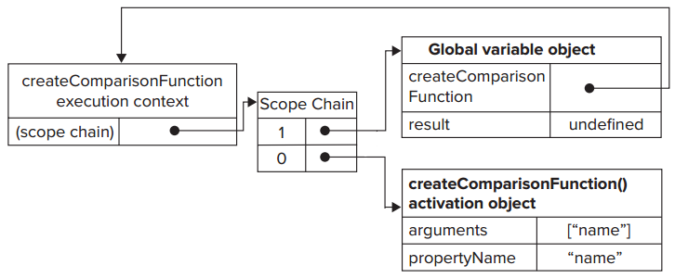
Closures Scope
function createComparisonFunction(propertyName) {}
var compare = createComparisonFunction("name");

Slide 35
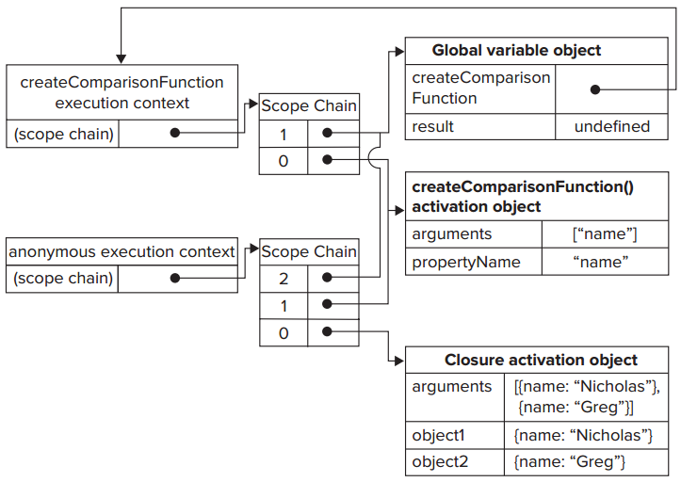
Closures Execution Context
function createComparisonFunction(propertyName) {
return function (object1, object2) {...}
}
//create function
var compareNames = createComparisonFunction("name");
//call function
var result = compareNames({ name: "Nicholas" }, { name: "Greg"});
//dereference function - memory can now be reclaimed
compareNames = null;

Slide 36
Closures and Variables
There is one notable side effect of this scope-chain configuration.
The closure always gets the last value of any variable from the containing function.
function createFunctions() {
var result = new Array();
for (var i = 0; i < 10; i++) {
result[i] = function () { return i; };
}
return result;
}
Every function returns 10, why?

Slide 37
Solution
function createFunctions(){
var result = new Array();
for (var i=0; i < 10; i++){
result[i] = (function(num){
return function(){ return num; };
})(i);
}
return result;
}
Called immediately
Create scope
I is copied into the argument num

Slide 38
The this Object Inside Closures
var name = "The Window";
var object = {
name : "My Object",
getNameFunc : function(){
return function(){ return this.name; };
}
};
alert( object.getNameFunc() () );
// "The Window"
// (in non-strict mode)
object = this
global= this

Slide 39
Solution
var name = "The Window";
var object = {
name : "My Object",
getNameFunc: function () {
var self = this;
return function () { return self.name; };
}
};
alert(object.getNameFunc() () );
// "My Object"

Slide 40
Solution With Bind Function
var name = "The Window";
var object = {
name : "My Object",
getNameFunc: function () {
return function () { return this.name; }.bind(this);
}
};
alert(object.getNameFunc() () );
// "My Object"

Slide 41
Closures vs. Prototypes
Closure
Prototype
function Point(x, y)
{
var _x = x;
var _y = y;
this.getX = function(){
return _x;
}
this.getY = function(){
return _y;
}
}
function Point(x, y)
{
this._x = x;
this._y = y;
}
Point.prototype =
{
getX: function(){
return this._x;},
getY: function() {
return this._y;}
}

Slide 42
Variable Pattern

Slide 43
Privileged Method
A privileged method is a public method that has access to private variables and/or private functions.
function MyObject() {
//private variables and functions
var privateVariable = 10;
function privateFunction() { return false; }
//privileged methods
this.publicMethod = function () {
privateVariable++;
return privateFunction();
};
}
Closures with full access to all variables and functions
defined inside the constructor’s scope.

Slide 44
Static Private Variables
Privileged methods can also be created by using a private scope to define the private variables or functions.
(function(){
//private variables and functions
var privateVariable = 10;
function privateFunction(){ return false; }
//constructor
MyObject = function(){ };
//public and privileged methods
MyObject.prototype.publicMethod = function () {
privateVariable++;
return privateFunction();
};
})();
global variable
The privileged method, being a closure, always holds a reference to the containing scope.

Slide 45
Static Private Variables
(function(){
var name = "";
Person = function(value){ name = value; };
Person.prototype.getName = function(){ return name; };
Person.prototype.setName = function (value){ name = value; };
})();
var person1 = new Person("Nicholas");
alert(person1.getName()); // ”Nicholas”
person1.setName("Greg");
alert(person1.getName()); // ”Greg”
var person2 = new Person("Michael");
alert(person1.getName()); // ”Michael”
alert(person2.getName()); // ”Michael”

Slide 46
The Module Pattern
The module pattern augments the basic singleton to allow for private variables and privileged methods.
var singleton = (function(){
//private variables and functions
var privateVariable = 10;
function privateFunction(){ return false; }
//privileged/public methods and properties
return {
publicProperty: true,
publicMethod : function(){
privateVariable++;
return privateFunction();
}
};
})();

Slide 47
Singleton Initialization
var application = function(){
//private variables and functions
var components = new Array();
//initialization
components.push(new BaseComponent());
//public interface
return {
getComponentCount : function(){ return components.length; },
registerComponent : function(component){
if (typeof component == "object"){
components.push(component);
}
}
};
}();

Slide 48
Recursion with Functions

Slide 49
Recursion
A recursive function typically is formed when a function calls itself by name.
function factorial(num) {
if (num <= 1) {
return 1;
} else {
return num * factorial(num - 1);
}
}

Slide 50
Recursion Problem
var anotherFactorial = factorial;
factorial = null;
alert( anotherFactorial(4) ); //error!
function factorial(num) {
if (num <= 1) {
return 1;
} else {
return num * arguments.callee(num - 1);
}
}
The value of arguments.callee is not accessible to a script running in strict mode and will cause an error when attempts are made to read it.

Slide 51
Recursion Solution
The name f remains the same even if the function is assigned to another variable, so the recursive call will always execute correctly.
var factorial = (function f( num ) {
if ( num <= 1 ){
return 1;
} else {
return num * f(num - 1);
}
});

Slide 52
Breaking Recursion
function processArray(items, process, callback) {
var todo = items.concat(); //create a clone of the original
setTimeout( function () {
process(todo.shift());
if (todo.length > 0) {
setTimeout( arguments.callee, 25 );
} else {
callback( items );
}
}, 25);
}

Slide 53
Garbage Collection
Two strategies have traditionally been used in browsers:
Mark-and-Sweep
Reference Counting
When data is no longer necessary, it’s best to set the value to null, freeing up the reference (dereferencing the value).

Slide 54

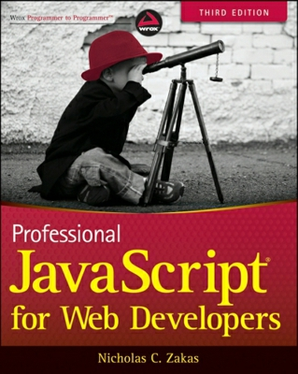
Resources
Professional JavaScript for Web Developers – book
High Performance JavaScript - book
Good links:
http://eyalvardi.wordpress.com/resources/html-5-course-resourses/javascript/

Slide 55
Thanks
eyalvardi.wordpress.com
Eyal Vardi
Microsoft MVP ASP.NET blog: eyalvardi.wordpress.com

